Slide 1



2021-22 Budget Advisory Committee
COTATI-ROHNERT PARK UNIFIED SCHOOL DISTRICT
PRESENTATION
DATE 3/31/22

Slide 2



Meeting Norms
Students First
Assume Positive Intent
Seek to understand multiple perspectives
Step up, step back

Slide 3
Purpose of BAC
PURPOSE: The purpose of the Superintendent’s Budget Advisory Committee (BAC) is to provide our constituents, and the greater CRPUSD school community with an understanding of education funding and the constraints and opportunities of the State and District budgeting process. Information will be shared on revenues and expenditures and on the status of the State budget and the District’s allocation of resources, constraints and opportunities of funding, timeline, calendar and the approval process.

Slide 4
Purpose of BAC
The SBAC has the responsibility for proposing budget recommendations to the Superintendent particularly in times when revenues do not meet projections or expenditures exceed revenues and budget corrections are needed.

Slide 5
State Budget Process
January
  Governor’s proposed budget for budget year
February
  Legislative Analyst review with comments
April
  Statutory COLA recalculated
May
  “May Revise” reflects tax adjustments
June 15 (or later)
  Final adopted State budget
    COLAs, “gap” funding
    Potential additional programs, or funding changes
November
  Legislative Analyst Report (LAO Report)
    Projections for next year based on tax collections and economic predictors
January
  Governor’s proposed budget for next budget year…

Slide 6
Components: Funding Factors
Notes:
STRS – over 2% increase in 2022-23 PERS – 2.49% increase

Slide 7
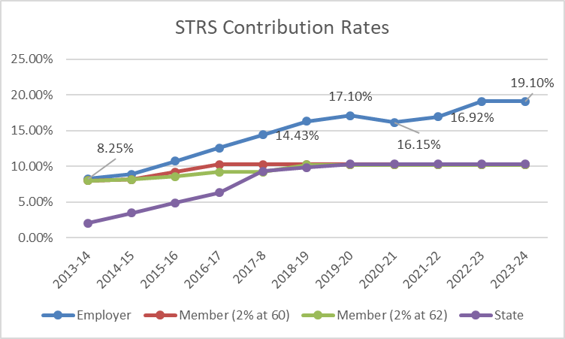
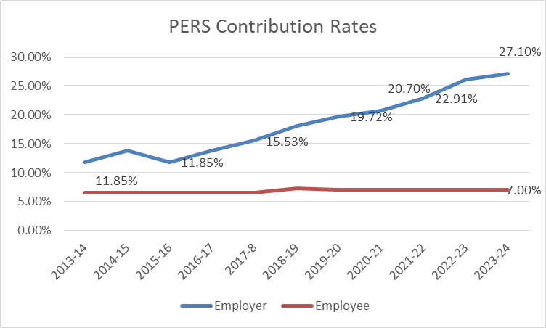
Components: Pension Reform
Notes:
STRS – over 2% increase in 2022-23 PERS – 2.49% increase

Slide 8
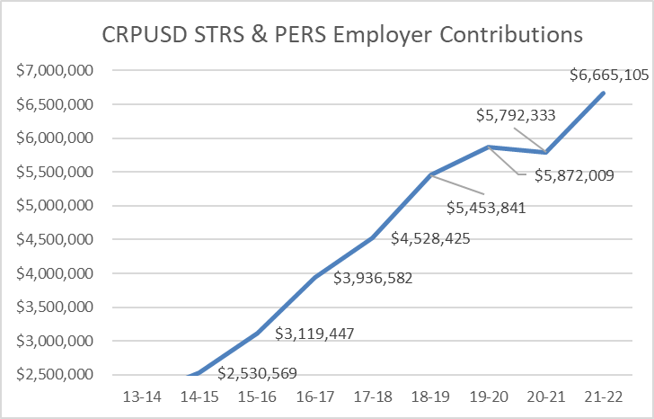
Components: Pension Reform
Notes:
STRS – over 2% increase in 2022-23 PERS – 2.49% increase

Slide 9
Key Budget Assumptions
Department of Finance COLA funding assumptions
Step and Column cost increases 1.5% annually
Assumes Health and Welfare cost increases 3% annually
Increased STRS & PERS costs accordingly using current projected rates
Enrollment up 279 students from last year
Funded Average Daily Attendance (ADA) projected at 5,551 (93.5% of projected enrollment) in subsequent years of MYP (historically 96%)
District unduplicated pupil count (UPC) well below the 55% threshold for Concentration Grant Funds
  District does not project receipt of these funds in foreseeable future
Labor negotiations not settled for any of the labor groups
  No costs for salary settlement included in MYP

Slide 10


General Fund Revenue Budget
General Purpose – Property taxes, basic state aide, and education protection account funds
Federal – District must follow specific grant guidelines (Title I, Title II, etc.)
Other State – State funds not part of State Aide (Lottery, Special Education, Mandate etc.)
Local – Funds received from local sources (Parcel Tax, Casino Funds, Foundation support, PTSA support, Interest, etc.)
Notes:
One-time revenue accounts for $5,526,939

Slide 11
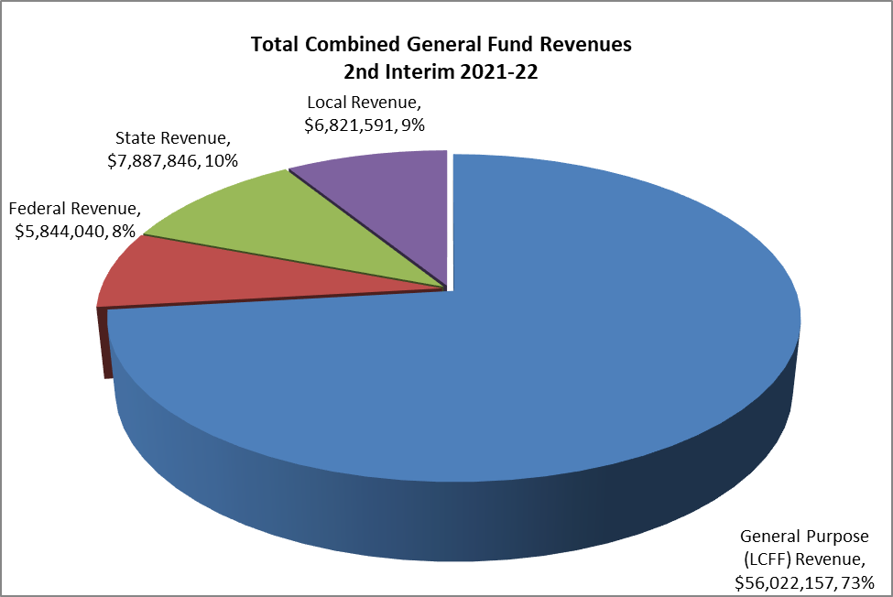
General Fund Revenue Budget
General Purpose – Property taxes, basic state aide, and education protection account funds
Federal – District must follow specific grant guidelines (Title I, Title II, etc.)
Other State – State funds not part of State Aide (Lottery, Special Education, Mandate etc.)
Local – Funds received from local sources (Parcel Tax, Casino Funds, Foundation support, PTSA support, Interest, etc.)
Notes:
Just under $73M in revenue

Slide 12
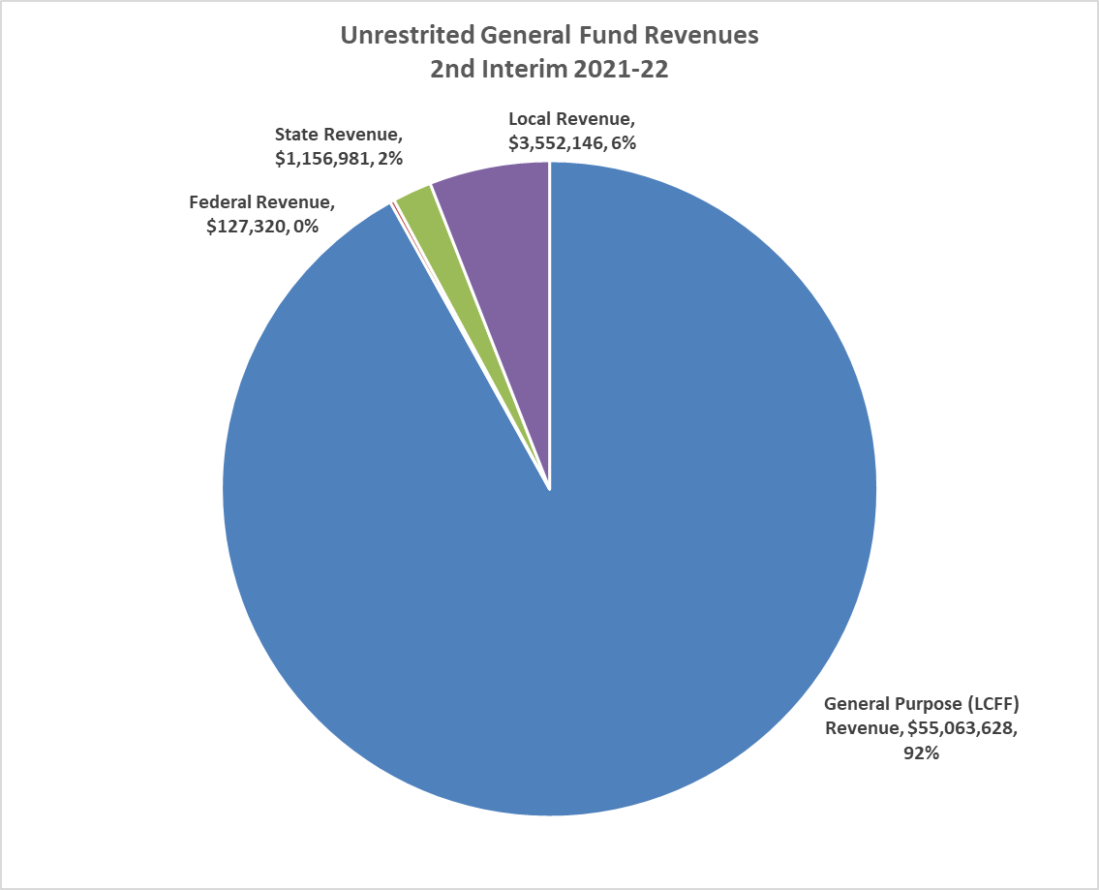
Unrestricted General Fund Revenue Budget
General Purpose – Property taxes, basic state aide, and education protection account funds
Federal – District must follow specific grant guidelines (Title I, Title II, etc.)
Other State – State funds not part of State Aide (Lottery, Special Education, Mandate etc.)
Local – Funds received from local sources (Parcel Tax, Casino Funds, Foundation support, PTSA support, Interest, etc.)
Notes:
Just under $73M in revenue

Slide 13
General Fund Expenditures
Reflects General Fund only (no Cafeteria, Bonds, Capital Facilities)
Employee costs comprise approximately 84% of the Districts unrestricted budget
Notes:
76% of Combined GF goes to salaries and benefits 84% unrestricted GF are people costs 43 FTE Cert & Class mgmt. We have spent or encumbered $5.7M of $7M unres and $7.6M of restricted Transportation, P&L Insurance, utilities, SpEd NPS,NPA

Slide 14
CRPUSD Expenditures Categories
Certificated Salaries | Credentialed Staff: Includes Teachers, Librarians, Nurses, Counselors, Psychologists, Principals, Superintendent
Classified Salaries | Non-Credentialed Staff: Office staff, Custodians, Managers, Supervisors, CBO
Employee Benefits | Salary driven benefit costs: Includes State Teachers Retirement (STRS), Public Employee Retirement (PERS), Workers Compensation, SUI, Social Security, Health benefit costs
Books and Supplies | Includes textbooks, computers, magazines, gas & oil
Services and Other Operating Expenses | General operating costs includes Insurance, utilities, repairs, contract services, internet, telephones
Capital Outlay | Capital includes equipment . Maintenance or repairs over $5,000
Transfer Out/Other Outgo | Transfers out include transfers to other funds (Example: Cafeteria Fund) or transfers to other agencies

Slide 15
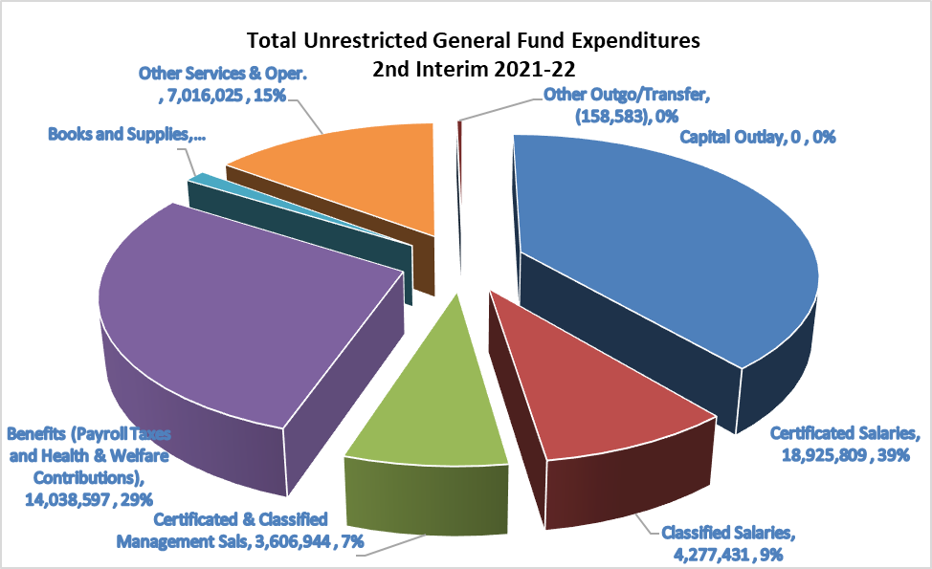
General Fund Unrestricted
Expenditures
Reflects General Fund only (no Cafeteria, Bonds, Capital Facilities)
Employee costs comprise approximately 84% of the Districts unrestricted budget
Notes:
78% of Combined GF goes to salaries and benefits 84% pf unrestricted GF are people costs

Slide 16
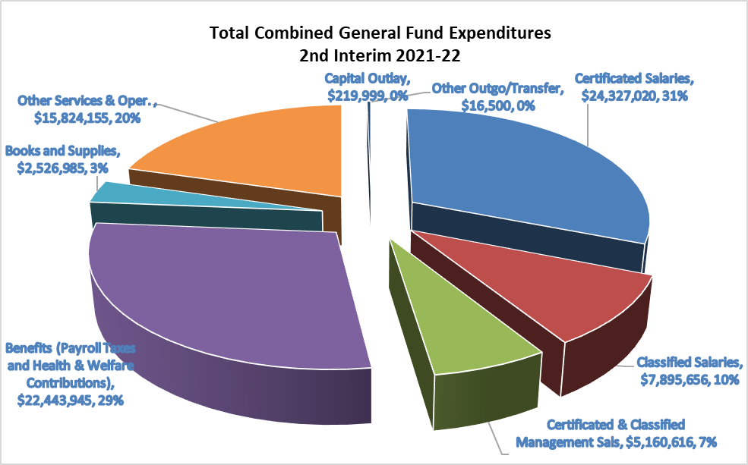
General Fund Combined
Expenditures
Reflects General Fund only (no Cafeteria, Bonds, Capital Facilities)
Employee costs comprise approximately 84% of the Districts unrestricted budget
Notes:
78% of Combined GF goes to salaries and benefits 84% pf unrestricted GF are people costs

Slide 17
Unrestricted Funds to Restricted Programs
Notes:
Less than 40% of SpEd funded by State and Federal government

Slide 18
Second Interim General Fund Summary

Slide 19
Summary Budget Adoption
Multi-Year Projection(MYP)
Notes:
Reserve Percentage must be at least 3% in Yr 3

Slide 20
Summary 1st Interim Multi-Year Projection (MYP)
Notes:
Reserve Percentage must be at least 3% in Yr 3

Slide 21
Summary 2nd Interim Multi-Year Projection (MYP)
Notes:
Reserve Percentage must be at least 3% in Yr 3

Slide 22
Summary 2nd Interim Multi-Year Projection (MYP) W/ Raises
Notes:
Our offer of 6%split, 5%split, 3.61%COLA

Slide 23
Second Interim Certification
Per AB 1200
The Second Interim projection indicates that, as defined in AB 1200, “the Cotati Rohnert Park Unified School District may not be able to meet its current financial obligations in this fiscal year or subsequent two years.”
The Cotati Rohnert Park Unified School District is self-certifying as “Qualified”

Slide 24
Uncertainties and Prudence
Enrollment increased significantly this year. Can we keep the students from leaving in the future?
Pension reform continues to escalate in out years of MYP
Positive revenue news coming down from the State. How will that affect Education Funding?
Special Education costs continue to escalate
Collective Bargaining

Slide 25

Questions?

Slide 26


