Slide 1



2021-22 Budget Advisory Committee
COTATI-ROHNERT PARK UNIFIED SCHOOL DISTRICT
PRESENTATION
DATE 5/19/22

Slide 2



Meeting Norms
Students First
Assume Positive Intent
Seek to understand multiple perspectives
Step up, step back

Slide 3
Purpose of BAC
PURPOSE: The purpose of the Superintendent’s Budget Advisory Committee (BAC) is to provide our constituents, and the greater CRPUSD school community with an understanding of education funding and the constraints and opportunities of the State and District budgeting process. Information will be shared on revenues and expenditures and on the status of the State budget and the District’s allocation of resources, constraints and opportunities of funding, timeline, calendar and the approval process.

Slide 4
State Budget Process
January
  Governor’s proposed budget for budget year
February
  Legislative Analyst review with comments
April
  Statutory COLA recalculated
May
  “May Revise” reflects tax adjustments
June 15 (or later)
  Final adopted State budget
    Final COLA
    Potential additional programs, or funding changes
November
  Legislative Analyst Report (LAO Report)
    Projections for next year based on tax collections and economic predictors
January
  Governor’s proposed budget for next budget year…
Notes:
One of my mentors told me that our budget or MYPs are only as good as the assumptions that are used to create them…in other words our budget changes based on what the state or federal government provides to us

Slide 5
District Budget Process
June 20xx
District’s preliminary budget presented to the board at 1st meeting in June
June 30, 20xx
District adopts budget for new budget year
December 15, 20xx
1st Interim State Report approved by the Board
March 15, 20xx
2nd Interim State Report approved by the Board
Sept 15, 20xx
Unaudited Actuals State Report approved by the Board
January 10, 20xx
1st look at next year’s State Budget. Used for Planning
District
Jan
Feb
Mar
Apr
May
Jun
Jul
Aug
Sept
Dec
January 10
Governor’s Budget for next fiscal year
May 15
May Revision – Updated info to Jan budget
June 30
Final State Budget adoption
State
Committees for both Assembly & Senate work on their versions of the budget
Final negotiations with Legislature & Governor
Notes:
Back in 2020 Districts in California adopted budgets that assumed 8% reduction to LCFF only to have that restored when the State adopted their budget. CRPUSD was looking at deficits of $2,5,& 7 million in that MYP by 2nd interim we were projecting ½ million surpluses

Slide 6
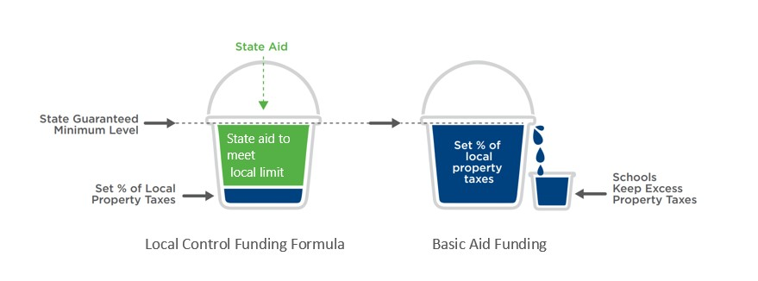
State Funded vs Basic Aid
District is entitled to a calculated Entitlement
  Comprised of property taxes and State Aid
  When property taxes don’t fill the bucket, the State makes up the shortfall with State Aid
District is entitled to a calculated Entitlement
  Comprised of property taxes and State Aid
  If Property taxes fill the bucket and overflow, the district keeps the overflow $$ and only receives a minimum amount of State Aid
Notes:
Neighboring Basic Aid Districts include Sonoma Valley, Healdsburg, Sebastopol Union, Old Adobe. An extreme example of the inequity in funding that different school districts face is a District that Trustee Brown talked about in a recent board meeting. St. Helena is a basic aid school District their per pupil funding was $33,476 last year CRPUSD per pupil funding was $13,682.

Slide 7
Components: Funding Factors
Notes:
STRS – over 2% increase in 2022-23 PERS – 2.46% increase COLA 2.48% at Budget Adoption 5.33% @ 1st interim 33% for class 21% for cert

Slide 8
Cost of Living Adjustment (COLA)
The Budget Act of 2021 provided the following COLAs:
  LCFF: 5.07%
  Special Education: 4.05%
  Categorical Programs: 1.7%
Governor's January Budget included a COLA of 5.33% for all programs.
The May Revision increases LCFF COLA to 6.56%
  Roughly $4.4 billion, an increase of $1.1 billion from January.
  Also increases COLA for specified categorical programs to 6.56%: Special Education, Child Nutrition, Adult Ed Block Grant, Mandate Block Grant, Foster Youth, American Indian Education Centers and American Indian Early Childhood Education.
Budget Act of 2021 | Governor's Budget | May Revision
5.07% | 5.33% | 6.56%

Slide 9
LCFF Revenue 2021-22

Slide 10
LCFF Revenue 2022-23
Notes:
$683,188 increase over 2nd interim revenue projection

Slide 11
General Fund Revenue per ADA
Notes:
The District’s total revenues/ADA are the second lowest and $2,587/ADA behind the comparative group.

Slide 12
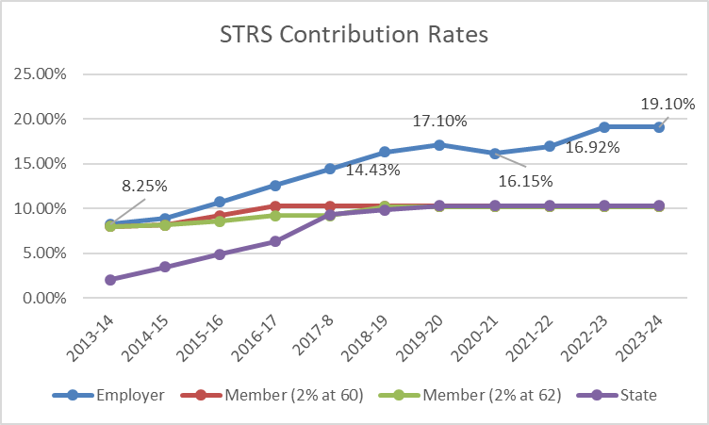
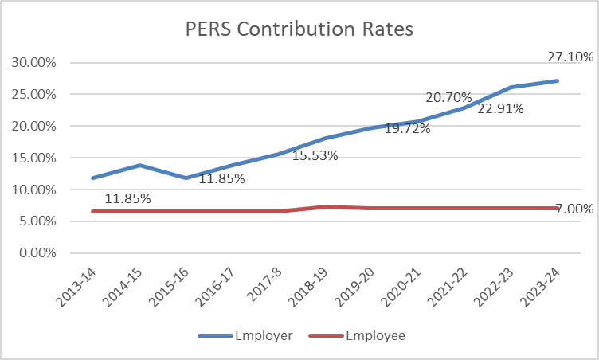
Components: Pension Reform
Notes:
STRS – over 2% increase in 2022-23 PERS – 2.69% increase

Slide 13
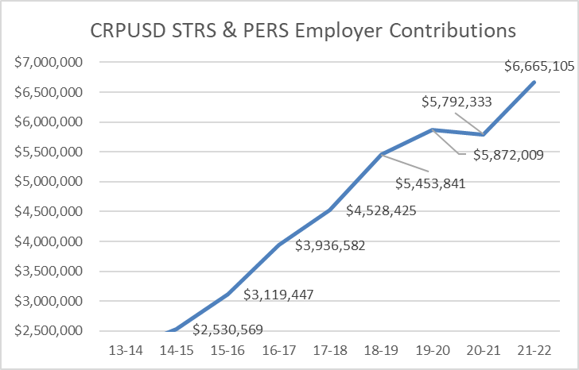
Components: Pension Reform
Notes:
STRS – over 2% increase in 2022-23 PERS – 2.46% increase

Slide 14
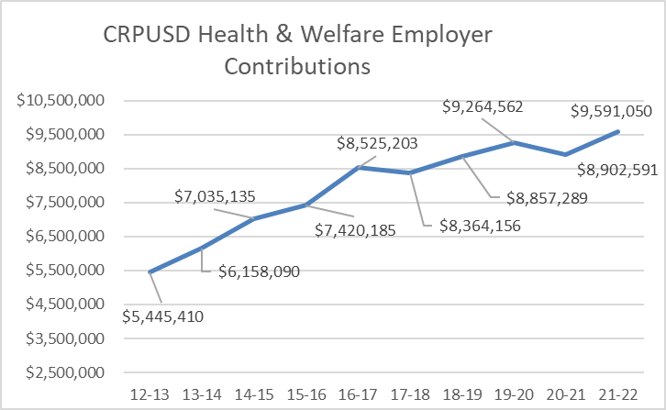
Components: Health & Welfare Costs
Notes:
5% increase = $479,552 3% increase = $287,732 Difference $191,820

Slide 15
Key Budget Assumptions
Department of Finance COLA funding assumptions
Step and Column cost increases 1.5% annually
Assumes Health and Welfare cost increases 3% annually
Increased STRS & PERS costs accordingly using current projected rates
Enrollment up 279 students from last year
Funded Average Daily Attendance (ADA) projected at 5,551 (93.5% of projected enrollment) in subsequent years of MYP (historically 96%)
District unduplicated pupil count (UPC) well below the 55% threshold for Concentration Grant Funds
  District does not project receipt of these funds in foreseeable future
Labor negotiations settled for RPCEA, SEIU, and CSEA

Slide 16


General Fund 2021-22 Revenue Budget
General Purpose – Property taxes, basic state aide, and education protection account funds
Federal – District must follow specific grant guidelines (Title I, Title II, etc.)
Other State – State funds not part of State Aide (Lottery, Special Education, Mandate etc.)
Local – Funds received from local sources (Parcel Tax, Casino Funds, Foundation support, PTSA support, Interest, etc.)
Notes:
One-time revenue accounts for $6.1M In 2020 State and Federal Government allocated $16.8M for Covid Relief / Learning Loss Mitigation / Elementary School & Secondary Emergency Relief (ESSER) to be spent thru 2024

Slide 17
COVID-19 Funding Resources – “One-Time Funds”
Notes:
Beginning 2020 State and Federal Government allocated $16.8M for Covid Relief / Learning Loss Mitigation / Elementary School & Secondary Emergency Relief (ESSER) to be spent thru 2024
$12.7M left to spend after 20-21 school year. We’ve spent $8.5M this year.

Slide 18
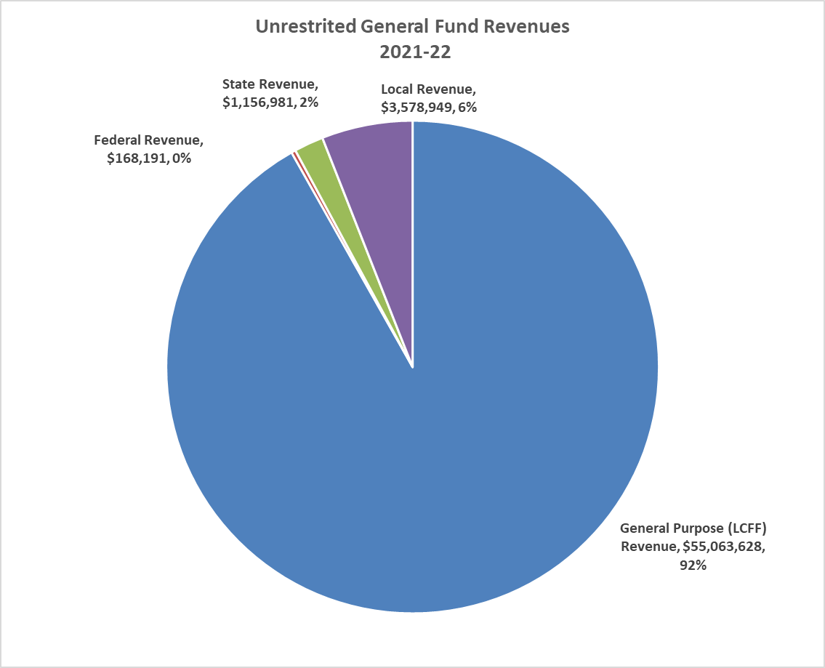
Unrestricted General Fund Revenue Budget
General Purpose – Property taxes, basic state aide, and education protection account funds
Federal – District must follow specific grant guidelines (Title I, Title II, etc.)
Other State – State funds not part of State Aide (Lottery, Special Education, Mandate etc.)
Local – Funds received from local sources (Parcel Tax, Casino Funds, Foundation support, PTSA support, Interest, etc.)
Notes:
Just under $60M in revenue

Slide 19
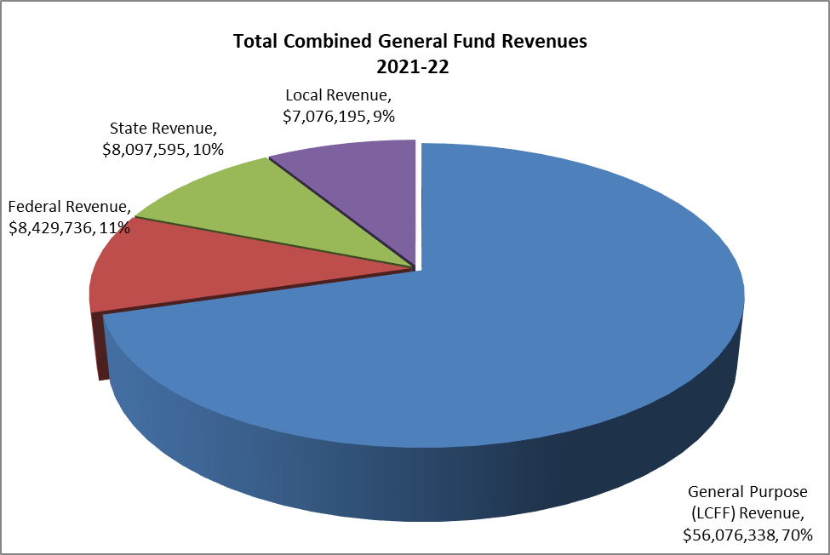
General Fund Revenue Budget
General Purpose – Property taxes, basic state aide, and education protection account funds
Federal – District must follow specific grant guidelines (Title I, Title II, etc.)
Other State – State funds not part of State Aide (Lottery, Special Education, Mandate etc.)
Local – Funds received from local sources (Parcel Tax, Casino Funds, Foundation support, PTSA support, Interest, etc.)
Notes:
Just under $80M in revenue

Slide 20
CRPUSD Expenditures Categories
Certificated Salaries | Credentialed Staff: Includes Teachers, Librarians, Nurses, Counselors, Psychologists, Principals, Superintendent
Classified Salaries | Non-Credentialed Staff: Office staff, Custodians, Managers, Supervisors, CBO
Employee Benefits | Salary driven benefit costs: Includes State Teachers Retirement (STRS), Public Employee Retirement (PERS), Workers Compensation, SUI, Social Security, Health benefit costs
Books and Supplies | Includes textbooks, computers, magazines, gas & oil
Services and Other Operating Expenses | General operating costs includes Insurance, utilities, repairs, contract services, internet, telephones
Capital Outlay | Capital includes equipment . Maintenance or repairs over $5,000
Transfer Out/Other Outgo | Transfers out include transfers to other funds (Example: Cafeteria Fund) or transfers to other agencies
Notes:
33% for class 21% for cert

Slide 21
General Fund Expenditures
Reflects General Fund only (no Cafeteria, Bonds, Capital Facilities)
Employee costs comprise approximately 85% of the Districts unrestricted budget
Notes:
75% of Combined GF goes to salaries and benefits 85% unrestricted GF are people costs 43 FTE Cert & Class mgmt. We have spent or encumbered $5.7M of $7M unres and $7.6M of restricted Transportation, P&L Insurance, utilities, SpEd NPS,NPA
Indirect costs are general mgmt costs which consist of administrative activities necessary for the general operation of the program, such as accounting, budgeting, payroll prep, personnel services, purchasing, and centralized data proc.

Slide 22
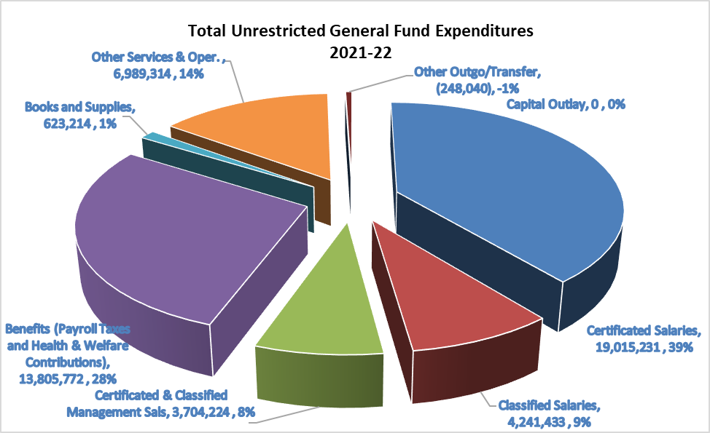
General Fund Unrestricted
Expenditures
Reflects General Fund only (no Cafeteria, Bonds, Capital Facilities)
Employee costs comprise approximately 85% of the Districts unrestricted budget
Notes:
78% of Combined GF goes to salaries and benefits 84% pf unrestricted GF are people costs

Slide 23
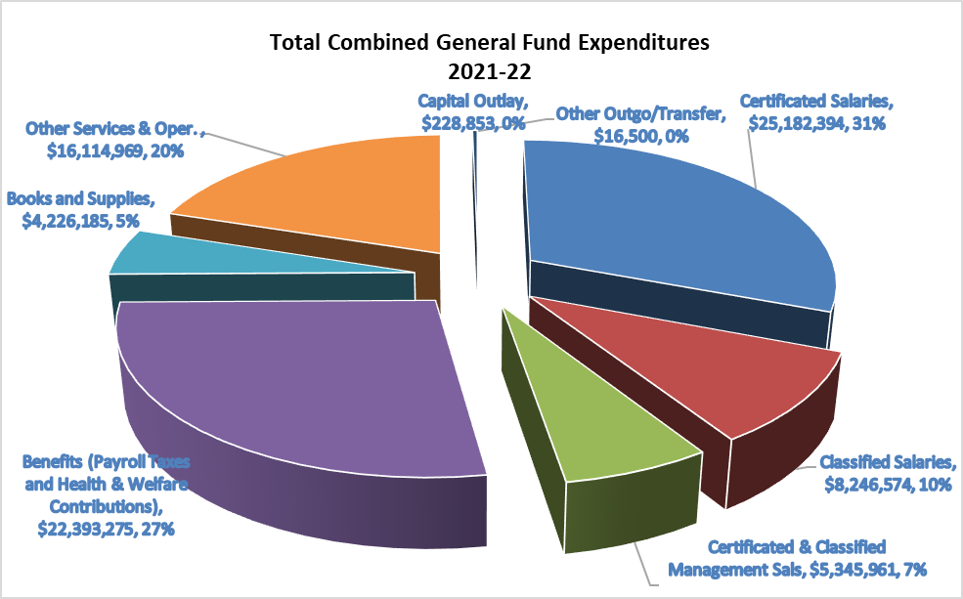
General Fund Combined
Expenditures
Reflects General Fund only (no Cafeteria, Bonds, Capital Facilities)
Employee costs comprise approximately 84% of the Districts unrestricted budget
Notes:
78% of Combined GF goes to salaries and benefits 84% pf unrestricted GF are people costs

Slide 24
Unrestricted Funds to Restricted Programs
Notes:
Less than 40% of SpEd funded by State and Federal government Individuals W Disabilities Education Act

Slide 25
General Fund Summary

Slide 26
General Fund Summary - Unrestricted

Slide 27
General Fund Summary - Restricted

Slide 28
Summary Budget Adoption
Multi-Year Projection(MYP)
Notes:
COLA 2.48% at Budget Adoption

Slide 29
Summary 1st Interim Multi-Year Projection (MYP)
Notes:
COLA 5.33% at 1st Interim

Slide 30
Summary Multi-Year Projection (MYP) W/ Raises
Notes:
Required to maintain 3% reserve

Slide 31
May Revision Proposals

Slide 32
LCFF Base Increase
In addition to the statutory COLA, the May Revision also provides a discretionary increase of $2.1 billion ongoing Proposition 98 General Fund to LCFF base funding .
Also provides $101.2 million ongoing to augment LCFF funding for county offices of education.
Notes:
10% augmented COLA applied to LCFF would result in additional $1.9M unrestricted

Slide 33
Discretionary Block Grant
May Revision includes $8 billion in one-time Proposition 98 General Fund discretionary funds, allocated on a per pupil basis.
Intent is to respond to LEA reports of increasing operation costs, including pension contributions.
Schools are intended to use funds for purposes including protecting staffing levels, addressing learning challenges and supporting staff and student mental health and wellness.
Funds will offset applicable mandates debt.
Notes:
Could be $7-8M in one-time unrestricted funding

Slide 34
Second Interim Certification
Per AB 1200
The Second Interim projection indicates that, as defined in AB 1200, “the Cotati Rohnert Park Unified School District may not be able to meet its current financial obligations in this fiscal year or subsequent two years.”
The Cotati Rohnert Park Unified School District is self-certifying as “Qualified”

Slide 35
Uncertainties and Prudence
Enrollment increased significantly this year. Can we keep the students from leaving in the future?
Pension reform continues to escalate in out years of MYP
Positive revenue news coming down from the State. How will that affect Education Funding?
Special Education costs continue to escalate
Collective Bargaining

Slide 36

Questions?

Slide 37


Slide 38
Unrestricted Expenditures: Other Services & Operations
Notes:
Spent $6,005,879 as of today
Placer County Office of Ed (PBIS) $40K

Slide 39
Special Education Budget
Notes:
40% of SpEd program funded by State and Federal Government $6,111,674 Other services & Operating Expenditures
$1.1M NPA, $398K NPA, $559K SCOE, $390K Board & Care

Slide 40
COVID ADA Relief
The May Revision includes fiscal protections for schools that experienced significant attendance declines in the current school year due to Delta and Omicron surges.
  Proposes allowing all LEAs to be funded at the greater of their current year average daily attendance or their current year enrollment adjusted for pre-COVID-19 absence rates in the 2021-22 fiscal year.
  Would also modify the three-year rolling average proposed in the January budget to conform with this adjustment.

