Slide 1



2021-22 First Interim Report
COTATI-ROHNERT PARK UNIFIED SCHOOL DISTRICT
SCHOOL BOARD PRESENTATION
DATE 12/14/21

Slide 2



2021-22 1st Interim State Report
California Education Code 42130 requires the Superintendent to prepare and submit two interim financial reports to the Board each fiscal year
After reviewing the report, California Education Code 42131requires the Board to certify the district’s ability to meet its financial obligations for the remainder of the current fiscal year as well as the following two fiscal years

Slide 3
2021-22 1st Interim State Report
Process:
Update the district budget for changes in revenues and expenditures since budget adoption using the most current information available and update multi-year projections (MYP) using the most current assumptions
The report is sent to the Sonoma County Office of Education (SCOE) for review. District will receive a letter from SCOE noting approval (or disapproval)

Slide 4
State Budget Process
January
  Governor’s proposed budget for budget year
February
  Legislative Analyst review with comments
April
  Statutory COLA recalculated
May
  “May Revise” reflects tax adjustments
June 15 (or later)
  Final adopted State budget
    COLAs, “gap” funding
    Potential additional programs, or funding changes
November
  Legislative Analyst Report (LAO Report)
    Projections for next year based on tax collections and economic predictors
January
  Governor’s proposed budget for next budget year…

Slide 5
Components: Funding Factors
Notes:
STRS – over 2% increase in 2022-23 PERS – 3.19% increase

Slide 6
What has changed since Budget Adoption?
Adjusted salaries and benefits to reflect actual projected costs
Posted carryover and budgets were increased accordingly within books, supplies and professional services
Local revenue budgets are adjusted as actual donations are received
Contributions to Special Education adjusted closer to projected actual costs

Slide 7
Key Budget Assumptions
All step and column adjustments, vacancies and late hires reflected in budget
Department of Finance COLA funding assumptions
Increased STRS & PERS costs accordingly using current projected rates
Enrollment up 279 students from last year
Funded Average Daily Attendance (ADA) projected at 5,509 (92% of projected enrollment) in subsequent years of MYP (historically 96%)
District unduplicated pupil count (UPC) well below the 55% threshold for Concentration Grant Funds
  District does not project receipt of these funds in foreseeable future
Labor negotiations not settled for any of the labor groups
  No costs for salary settlement included in MYP

Slide 8

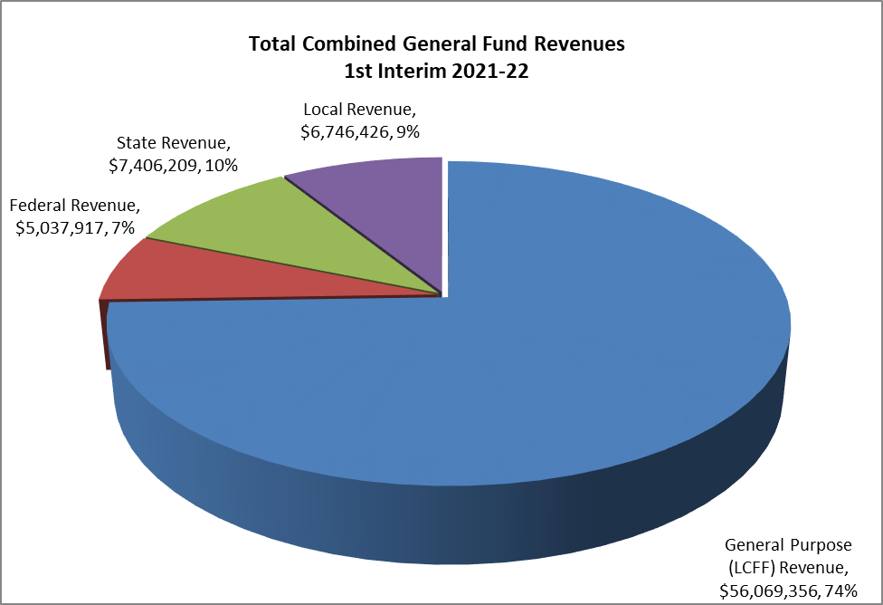
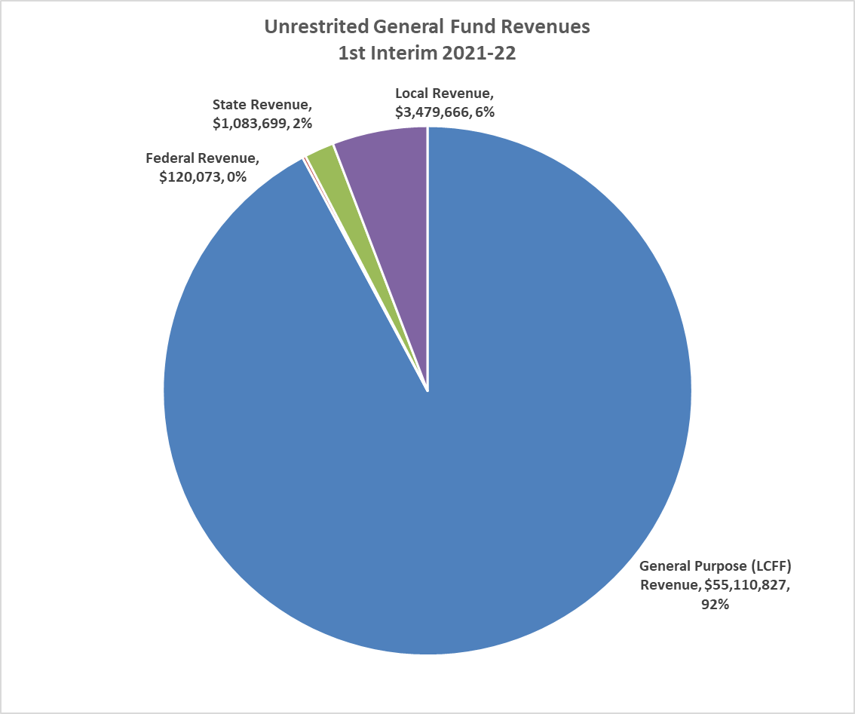

General Fund Revenue Budget
General Purpose – Property taxes, basic state aide, and education protection account funds
Federal – District must follow specific grant guidelines (Title I, Title II, etc.)
Other State – State funds not part of State Aide (Lottery, Special Education, Mandate etc.)
Local – Funds received from local sources (Parcel Tax, Casino Funds, Foundation support, PTSA support, Interest, etc.)
Notes:
Just under $73M in revenue

Slide 9
CRPUSD Expenditures Categories
Certificated Salaries | Credentialed Staff: Includes Teachers, Librarians, Nurses, Counselors, Psychologists, Principals, Superintendent
Classified Salaries | Non-Credentialed Staff: Office staff, Custodians, Managers, Supervisors, CBO
Employee Benefits | Salary driven benefit costs: Includes State Teachers Retirement (STRS), Public Employee Retirement (PERS), Workers Compensation, SUI, Social Security, Health benefit costs
Books and Supplies | Includes textbooks, computers, magazines, gas & oil
Services and Other Operating Expenses | General operating costs includes Insurance, utilities, repairs, contract services, internet, telephones
Capital Outlay | Capital includes equipment . Maintenance or repairs over $5,000
Transfer Out/Other Outgo | Transfers out include transfers to other funds (Example: Cafeteria Fund) or transfers to other agencies

Slide 10
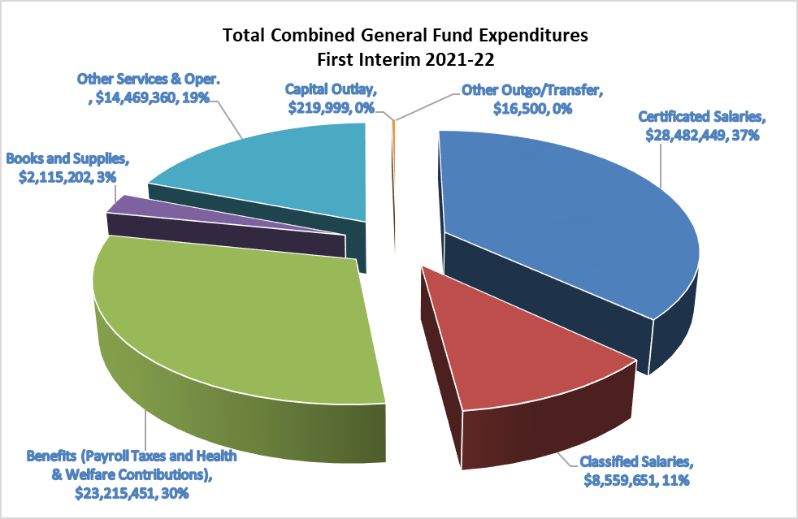
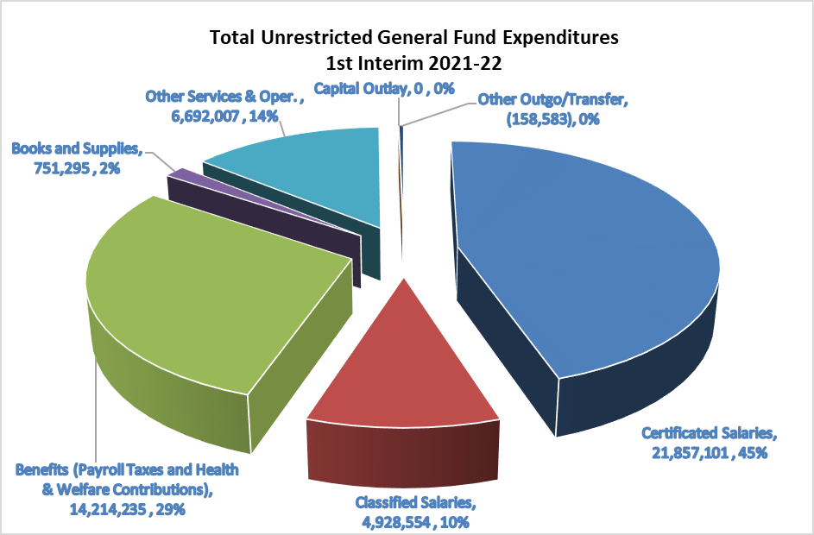

General Fund Expenditures
Reflects General Fund only (no Cafeteria, Bonds, Capital Facilities)
Employee costs comprise approximately 87% of the Districts unrestricted budget
Notes:
78% of Combined GF goes to salaries and benefits 85% pf unrestricted GF are people costs

Slide 11
Change in Fund Balance since
Budget Adoption

Slide 12
First Interim General Fund Summary

Slide 13
Summary Multi-Year Projection (MYP)
Notes:
Reserve Percentage must be at least 3% in Yr 3

Slide 14
Cash Flow
There will be months where the general fund reflects negative cash balances (districts pay their bills faster than property taxes come in)
  This is why districts, especially those that are deficit spending, must maintain larger fund balances than the meager state 3% minimum. Larger reserves lead to larger cash balances.
The June 30, 2021 cash balance is projected to be positive for the district, however, the “dry period” of October through December, before property taxes are received, indicates cash shortfalls
  The District has prepared to cover short-term borrowing from County Office of Ed funds for the current year (a Tax Anticipation Note)

Slide 15
Uncertainties and Prudence
Enrollment increased significantly this year. Can we keep the students from leaving in the future?
Pension reform continues to escalate in out years of MYP
Good news coming down from the State. How will that affect Education Funding?
Special Education costs continue to escalate
Collective Bargaining

Slide 16
First Interim Certification
Per AB 1200
The First Interim projection indicates that, as defined in AB 1200, “the Cotati Rohnert Park Unified School District will be able to meet its financial obligations for the current fiscal year and subsequent two years.”
The Cotati Rohnert Park Unified School District is self-certifying as “Positive”

Slide 17

Questions?

Slide 18


Slide 19

Proposition 98 and the Education Budget
Proposition 98 in the 2022-23 Governor’s Budget reaches an all-time high
  Provides $16.1 billion in new revenues for K-14 education
  But there are strings
    For the first time, most school districts will be required to spend down their reserves
    A sizeable share of new funding is proposed for restricted purposes, leaving few resources to address increased costs associated with soaring inflation and rising pension obligations

Slide 20
Budget Surplus
Just a little over a year-and-a-half ago, California enacted a budget to address a daunting
$54 billion deficit as a result of the stultifying impact of COVID-19 on our economy
  We withstood the imposition of tens of billions of dollars in deferred education payments and suspended cost of living adjustments
The Governor’s 2022-23 Budget is built on the solid foundation of an estimated $45.7 billion budget surplus and proposals that leave California on sound fiscal footing through 2025-26
Surplus Spending Plan
$20.6 billion
$16.1 billion
$9.0 billion
Discretionary
Public Education
Reserves and Debt Reduction

Slide 21
Proposition 98
The Governor’s spending of new Proposition 98 revenues relies heavily on one-time investments
  General apportionment formulas for K-12 and community colleges are increasing by COLA only, or 5.33%

Slide 22
Proposition 98
Most of the new Proposition 98 revenues for K-12 and community colleges are earmarked for specific categorical programs or services
  Total per-student K-12 spending reaches $15,261 (Proposition 98 only)
Note: K-12 core funding includes Proposition 98 adjustment for universal TK and lower classroom ratios in TK

Slide 23
2022-23 LCFF Overview
$3.3 Billion
Funds the 5.33% statutory COLA
$70.5 Billion
Total 2022-23 LCFF funding
$587
Approximate average increase in per-pupil funding
(individual amounts will vary)
Average ADA
Proposed change to help school districts with the fiscal impacts of declining enrollment

Slide 24
SSC Financial Projection Dartboard
Planning Factors
 | 2021-22 | 2022-23 | 2023-24 | 2024-25 | 2025-26
DOF* Planning COLA | 5.07%** | 5.33% | 3.61% | 3.64% | 3.62%
CalSTRS*** | 16.92% | 19.10% | 19.10% | 19.10% | 19.10%
CalPERS*** | 22.91% | 26.10% | 27.10% | 27.70% | 27.80%
Unemployment Insurance | 0.50% | 0.50% | 0.20% | 0.20% | 0.20%
*Department of Finance (DOF)
**Calculated by compounding the unfunded COLA of 2.31% from 2020-21 and the statutory COLA of 1.70%, plus 1.00%, in 2021-22
***California State Teachers' Retirement System (CalSTRS); California Public Employees’ Retirement System (CalPERS)
COLA is at higher levels
  But so are the projected cost increases that are facing LEAs
The journey the COLA has taken us on has been quite a wild ride

Slide 25
2022-23 ADA “Cliff”
The ADA “Cliff” has been well-publicized and the subject of many discussions
  For charter schools and COEs, the impact is already being felt in 2021-22
Good news—the Governor and Legislature are listening and hearing your collective voices
2019-20
2020-21
2021-22
2022-23
ADA
Funded ADA
Based on 2019-20
Funded ADA Based on 2019-20
The Cliff
2020-21
Actual ADA
2021-22
Actual ADA
Funded ADA
Based on 2021-22
2022-23
Actual ADA
© 2022 School Services of California Inc.

Slide 26





ADA Cliff—Proposed Solution
Many solutions have been entertained, and the Governor included one additional option:
Education Code Section (EC §) 42238.05(a)(1) provides funding through the LCFF on the greater of:
Current Year ADA
or
Prior Year ADA
Funding would be based on the greater of:
Current-Year ADA,
Prior-Year ADA
or
Computed average ADA using the prior three years’ ADA
Current Law for
School Districts
Governor’s Proposal for
School Districts

Slide 27
ADA Cliff—Proposed Solution
Hypothetical scenario for school districts
Fiscal Year | Actual ADA
2019-20 | 10,000
2020-21 | 10,000*
2021-22 | 9,500
2022-23 | 9,250
Funded ADA for 2022-23 | Funded ADA
Current Law | 9,500
Governor’s Proposal | 9,833
Difference | 333
*Result of hold harmless
Goal is to turn the ADA cliff into an ADA softer landing
The proposed solution would not apply to charter schools, but the Governor intends to engage in outreach and discussions with interested charter school parties
  No future changes were noted for COEs

