Slide 1



2025-26 First Interim Report
COTATI-ROHNERT PARK UNIFIED SCHOOL DISTRICT
SCHOOL BOARD PRESENTATION
DATE 12/9/25

Slide 2



2025-26 1st Interim State Report
California Education Code 42130 requires the Superintendent to prepare and submit two interim financial reports to the Board each fiscal year
After reviewing the report, California Education Code 42131 requires the Board to certify the district’s ability to meet its financial obligations for the remainder of the current fiscal year as well as the following two fiscal years
Notes:
This is the first of 2 opportunities for the board to certify our ability to pay our bills for this year +2

Slide 3
2025-26 1st Interim State Report
Process:
Update the district budget for changes in revenues and expenditures since budget adoption using the most current information available and update multi-year projections (MYP) using the most current assumptions
The report is sent to the Sonoma County Office of Education (SCOE) for review. District will receive a letter from SCOE noting approval (or disapproval)

Slide 4

State Budget Process
January
Governor’s proposed budget for budget year
February
Legislative Analyst review with comments
April
Statutory COLA recalculated
May
“May Revise” reflects tax adjustments
June 15 (or later)
Final adopted State budget
COLAs, “gap” funding
Potential additional programs, or funding changes
November
Legislative Analyst Report (LAO Report)
Projections for next year based on tax collections and economic predictors
January
Governor’s proposed budget for next budget year…

Slide 5
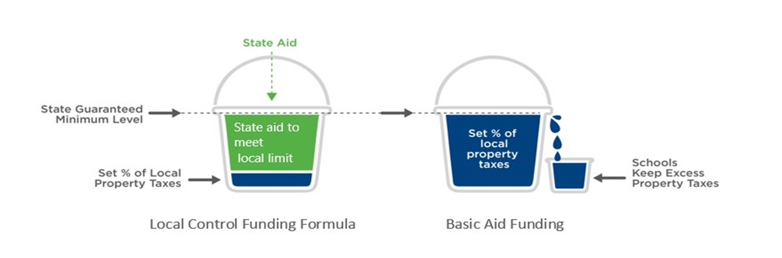
State Funded vs Basic Aid
District is entitled to a calculated Entitlement
Comprised of property taxes and State Aid
When property taxes don’t fill the bucket, the State makes up the shortfall with State Aid
District is entitled to a calculated Entitlement
Comprised of property taxes and State Aid
If Property taxes fill the bucket and overflow, the district keeps the overflow $$ and only receives a minimum amount of State Aid
Notes:
$36.2M in prop taxes of $79.2M in LCFF Rev = $43.0M away from being basic aid
Neighboring Basic Aid Districts include Sonoma Valley, Healdsburg, Sebastopol Union, Old Adobe.

Slide 6
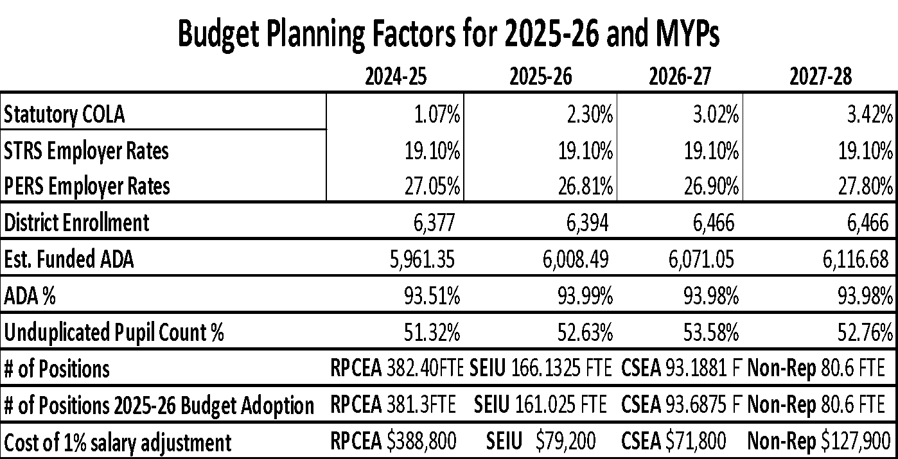
Components: Funding Factors
Notes:
1% change in COLA = $800K that compounds
1% change in ADA = $800K
-237 enrollment vs. Budget Adoption
-199.7 ADA vs. budget adoption due to 93.99% ADA projection
+1.1 FTE teachers
+5.1FTE SEIU staff

Slide 7



Components: Staffing
Notes:
RPCEA 23.17FTE
5.0 TK FTE
10.0 SpEd FTE
2.4 Speech FTE
3.8 Prop.28 Teacher FTE
1.0 Teacher ELCO
1.0 Teacher(s) TMS
SEIU 44.2425FTE
1.695 FTE EL Assistants
6.08 FTE I/A Gen Ed
9.0 FTE Student Support Advisors
27.4675 SpEd I/As
CSEA 4.3781FTE
4.3781 FTE Community Liasion
Mgmt/Non-Rep 2.6
1.6 SpEd Program Specialists
1.0 Elementary AP

Slide 8
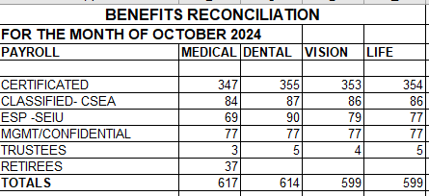
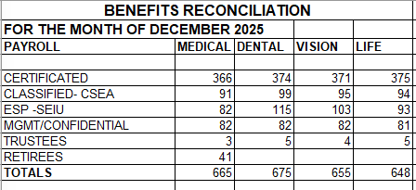
Components: Health & Welfare Benefits Participation

Slide 9
2025-26 School District and Charter School LCFF Funding Factors
Grade Span | TK-3 | 4-6 | 7-8 | 9-12
2024-25 Base Grant per ADA | $10,025 | $10,177 | $10,478 | $12,144
2.30% COLA | $231 | $234 | $241 | $279
2025-26 Base Grant per ADA | $10,256 | $10,411 | $10,719 | $12,423
GSA | $1,067 | – | – | $323
2025-26 Adjusted Base Grant per ADA | $11,323 | $10,411 | $10,719 | $12,746
20% Supplemental Grant per ADA¹ | $2,265 | $2,082 | $2,144 | $2,549
65% Concentration Grant per ADA² | $3,312 | $3,045 | $3,135 | $3,728
TK Add-On per ADA (inclusive of COLA) | $5,545³ | – | – | –
¹Maximum amount per ADA—to arrive at LEA’s grant amount, multiply adjusted base grant per ADA by 20% and UPP ²Maximum amount per ADA—to arrive at LEA’s grant amount, multiply adjusted base grant per ADA by 65% and UPP above 55% ³Inclusive of an additional $2,397 per TK ADA for the student-to-adult ratio reduction from 12:1 to 10:1

Slide 10
What has changed since Budget Adoption?
Adjusted salaries and benefits to reflect actual projected costs
Posted carryover and budgets were increased accordingly within books, supplies and professional services
Local revenue budgets are adjusted as actual donations are received
Contributions to Special Education adjusted closer to projected actual costs
-237 Enrollment
-199.7 ADA decrease (assuming 93%+ attendance rate)

Slide 11
Key Budget Assumptions
All step and column adjustments, vacancies and late hires reflected in budget
Department of Finance published COLA funding assumptions
Increased STRS & PERS costs accordingly using current projected rates
4% increase to health & welfare benefits
Funded Average Daily Attendance (ADA) projected at 6,008.49 (current est. ADA) for 2025-26
Funded ADA for 2026-27 of 6,075.4 (current projected ADA for 2026-27)
Funded ADA for 2027-28 of 6,075.4 (current projected ADA for 2027-28)

Slide 12
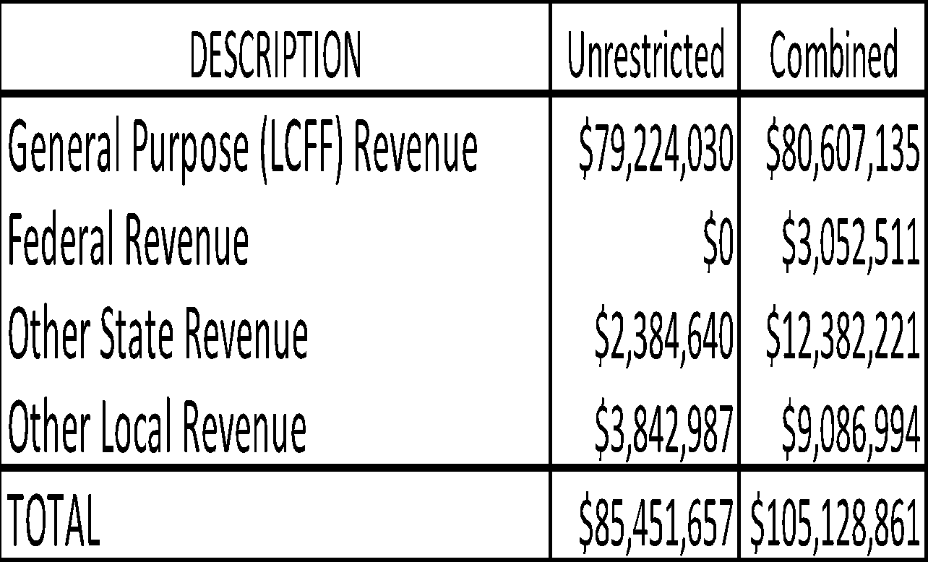
General Fund 2025-26 Revenue Budget
General Purpose – Property taxes, basic state aide, and education protection account funds
Federal – District must follow specific grant guidelines (Title I, Title II, etc.)
Other State – State funds not part of State Aid (Lottery, Special Education, Mandate etc.)
Local – Funds received from local sources (Parcel Tax, Casino Funds, Foundation support, PTSA support, Interest, etc.)
Notes:
One-time revenue accounts for $2.9M of $5.2M left to spend in one-time $$$ with due dates between 2026-2028

Slide 13

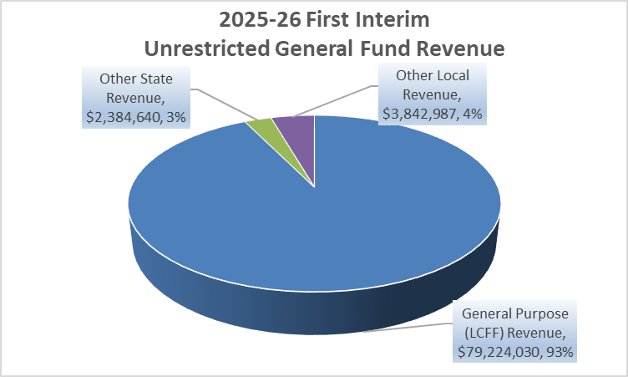
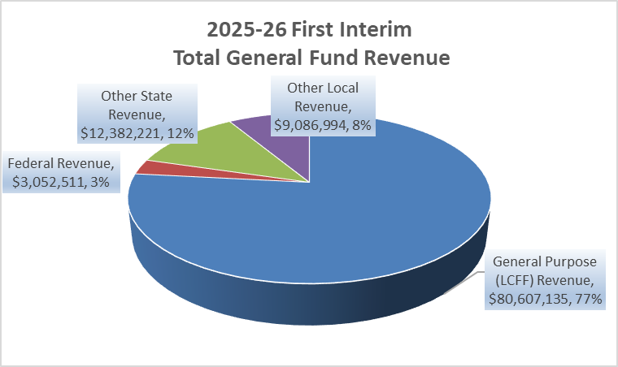

General Fund Revenue Budget
General Purpose – Property taxes, basic state aide, and education protection account funds
Federal – District must follow specific grant guidelines (Title I, Title II, etc.)
Other State – State funds not part of State Aide (Lottery, Special Education, Mandate etc.)
Local – Funds received from local sources (Parcel Tax, Casino Funds, Foundation support, PTSA support, Interest, etc.)

Slide 14

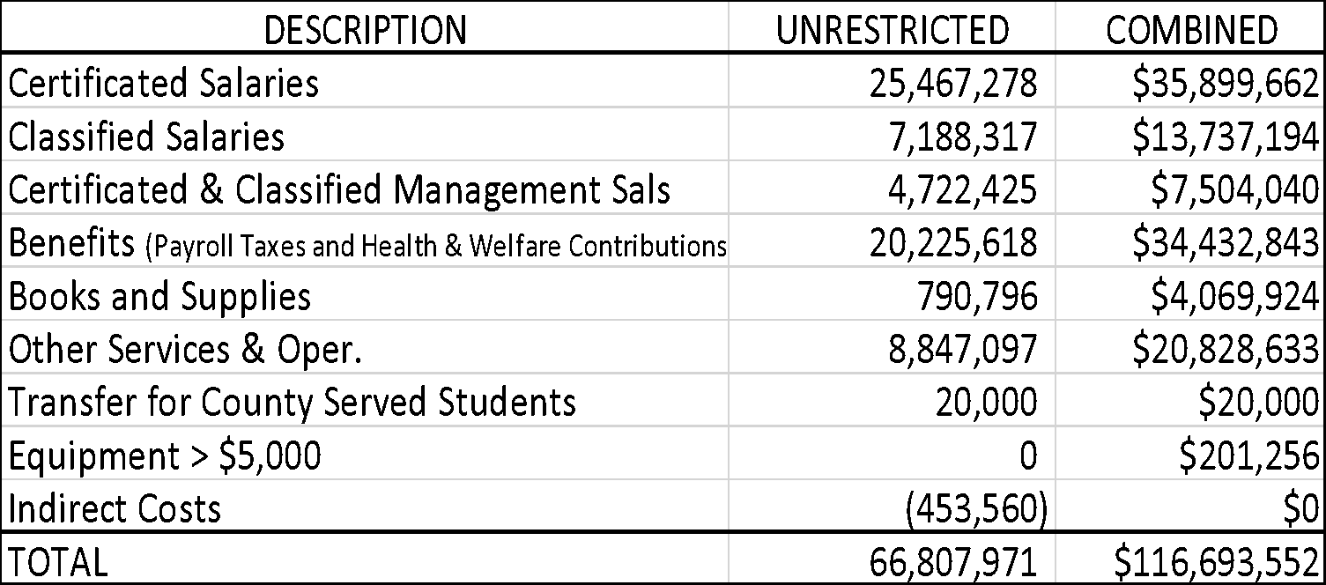
General Fund Expenditures
Reflects General Fund only (no Cafeteria, Bonds, Capital Facilities)
Employee costs comprise approximately 86% of the Districts unrestricted budget
Notes:
When you include NPA and NPS costs to employee costs over 81.5% of the total general fund budget goes toward people
Indirect costs are general mgmt costs which consist of administrative activities necessary for the general operation of the program, such as accounting, budgeting, payroll prep, personnel services, purchasing, and centralized data proc.

Slide 15
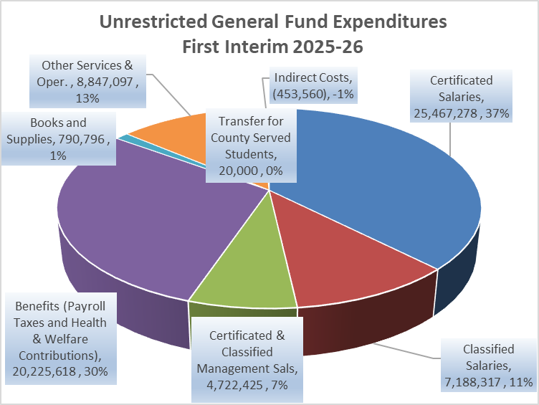
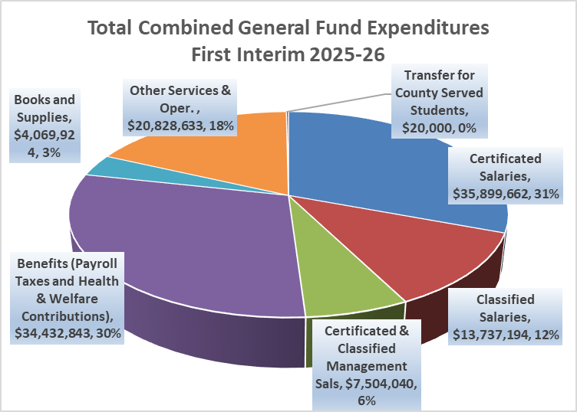

General Fund Expenditures
Reflects General Fund only (no Cafeteria, Bonds, Capital Facilities)
Employee costs comprise approximately 86% of the Districts unrestricted budget
Notes:
78% of Combined GF goes to salaries and benefits 86% pf unrestricted GF are people costs

Slide 16
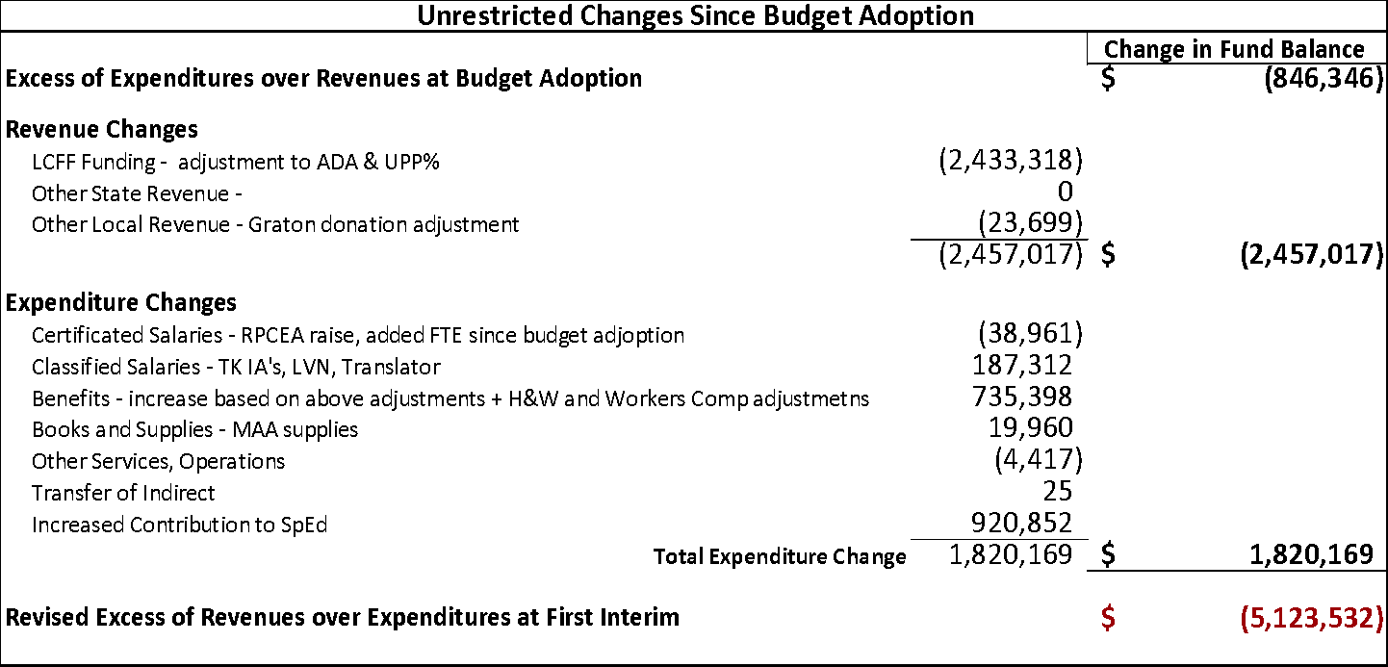
Change in Fund Balance since
Budget Adoption

Slide 17
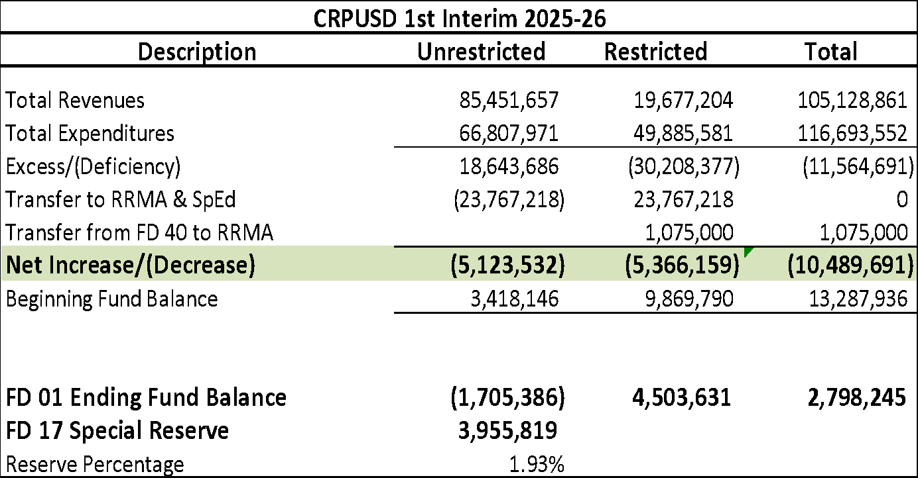
First Interim General Fund Summary

Slide 18
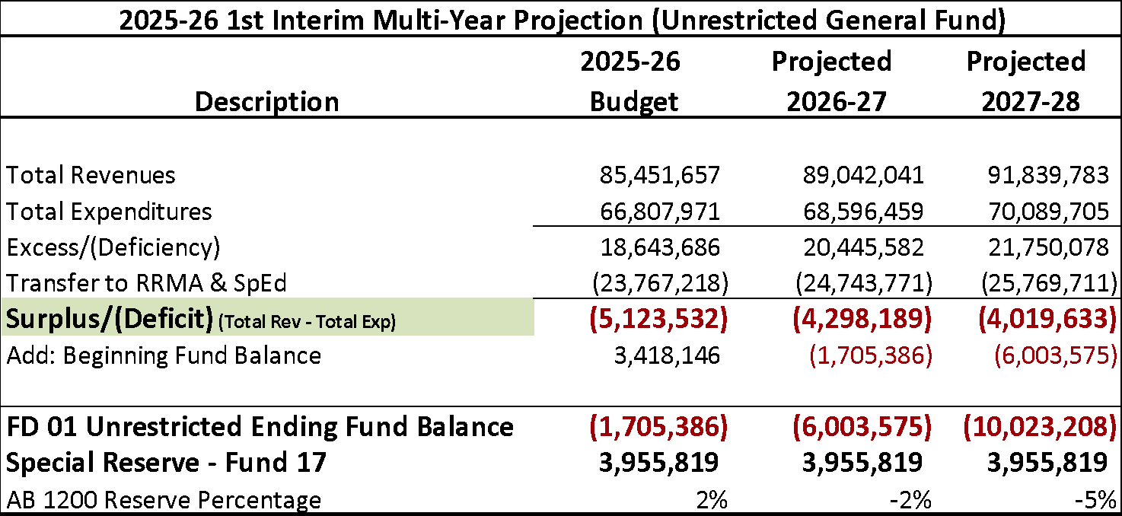
Summary Multi-Year Projection (MYP)

Slide 19
Cash Flow
There may be months where the general fund reflects negative cash balances (districts pay their bills faster than property taxes come in)
This is why districts, especially those that are deficit spending, must maintain larger fund balances than the meager state 3% minimum. Larger reserves lead to larger cash balances.
The June 30, 2026 cash balance is projected to be positive for the district.
Should there be any unexpected cash shortfalls throughout the year, the District has prepared to cover short-term borrowing from County Office of Ed funds for the current year (a Tax Anticipation Note)

Slide 20
Areas of Financial Concern
Enrollment/ADA trends
Future impact of STRS/PERS and COLA
Increases in general cost of doing business
Containing Special Education costs
Future Collective Bargaining

Slide 21
First Interim Certification
Per AB 1200
The First Interim projection indicates that, as defined in AB 1200, “the Cotati Rohnert Park Unified School District will be able to meet its financial obligations for the current fiscal year and may not be able to meet its financial obligations during subsequent two years.”
The Cotati Rohnert Park Unified School District is self-certifying as “Qualified”

Slide 22

Questions?

Slide 23


