Slide 1
Overview of P/L Program costs
Cotati-Rohnert Park Budget Committee
February 23, 2023

Slide 2
A primer on risk pools:
Risk pools were born out of the need for public entities/schools to have insurance due to the commercial insurance marketplace ceasing to provide coverage in California as a reaction to adverse legislation removing public agency immunities.
California passed legislation that allowed risk pools to form joint powers authorities to provide insurance and other services as separate public agencies
RESIG was formed July 1, 1979, to provide quality, cost-effective risk management programs and services to the public school districts, and later approved charter schools, of Sonoma County. Cotati-Rohnert Park is an original member.
RESIG has four programs: Property/Liability, Workers Compensation, Environmental Health & Safety, and Employee Benefits-Medical/Dental/Vision

Slide 3
RESIG’s no-cost services help minimize costs. CRPUSD has access to resources within the P/L, EHS, and WC programs
Risk prevention services (EHS)
Inspections
OSHA training
Indoor air quality testing*
Wildfire exposure assessments
Property appraisals/valuations
Cyber security assessments**
Online mandatory training programs
Childhood sexual abuse prevention resources and toolkits
Ergonomic evaluations
Post-Offer Pre-Placement Exams
Claims mitigation services
Local control and provider relationships
Prompt attention and handling of claims
Investigations
Defense counsel
Expert settlement assistance
Fire/smoke mitigation training
Pre-approved restoration services
*minimal cost for lab fees
**piloting

Slide 4
Additional RESIG support for members:
Course of Construction coverage up to $25M
Active Shooter Liability Coverage*
Flood coverage*
Payment of Schools Excess Liability Fund Assessments
RESIG overall $1.6M
Cotati-Rohnert Park’s share was approximately $294,000
*subject to policy conditions, provisions, and exclusions.

Slide 5
Since 2017 global catastrophic events have negatively impacted the property insurance marketplace

Slide 7
Local catastrophic events had impact on property insurance availability and costs
Local catastrophic events:
2017 Tubbs Fire (RESIG paid the first $100,000, excess insurance paid $8.1M)
2019 Kincaid Fire (At this time districts were responsible for the first $5M of losses)
Because of these catastrophic events occurring locally, insurers have been reluctant to provide wildfire coverage in California and specifically in Sonoma County
RESIG took action and partnered with other Northern California JPAs in 2019 to form the Schools Program Alliance (SPA) to group purchase property coverage including wildfire at the most-cost effective pricing available through London and US-based insurers.
RESIG’s limits are now higher and the wildfire deductible has been reduced

Slide 8
Historical fire map of Sonoma County
Recent fire behavior has been unpredictable, establishing new burn scars toward the western parts of Sonoma County
Prior to the Kincaid Fire in 2019, no fire had burned close to Healdsburg or Windsor.
Although the Cotati-Rohnert Park area has yet to be impacted, there is possibility (or risk) that a future catastrophic fire may occur. The tree canopy is beautiful, but is a red flag for property insurance underwriters

Slide 9
Who was impacted by the 2017 Tubbs and 2019 Kincaid fires?

Slide 10
General Liability has seen increased costs also

Slide 11
Legislation and court judgements have impacted Liability costs
Childhood Sexual Abuse:
2019 – AB218 Childhood Sexual Abuse Act
Opened a window for 3 years during which claims for childhood sexual abuse could be filed for instances occurring at any time in the past
Changed the statute of limitations to apply until 22 years after the age of majority (to age 40)
OR three (3) years after remembering an instance of childhood sexual abuse
Redefined childhood sexual abuse to be very broadly applied
There is pending legislation to eliminate the statute of limitations for public agencies – AB452
Other areas are seeing high-valued claims also:
Special Education
Transportation
Traumatic Brain Injuries

Slide 12
General Liability costs have increased
Courts and juries have been extremely sympathetic to claimants
Judgements exceed available insurance in some instances
Submitted claims have resulted in assessments from prior coverage programs
RESIG has covered these assessments on behalf of members totaling $1.6M
Many insurers are not willing to provide coverage to California schools
If coverage is available, Premiums have increased substantially AND some coverage has limitations

Slide 13
These factors have impacted RESIG’s costs to provide P/L coverage to members

Slide 14
RESIG Property and Liability Contributions (total pool)
Program Year | 2017/18 | 2018/19 | 2019/20 | 2020/21 | 2021/22 | 2022/23
RESIG self insured Self-Insured retention (Pr) Self-Insured retention (GL) | $2,394,837 $100,000 $100,000 | $2,542,635 $250,000 $100,000 | $2,872,492 $5,000,000 $250,000 | $3,671,307 $5,000,000 $250,000 | $3,983,960 $2,500,000 $250,000 | $3,871,767 $2,500,000 $250,000
Excess Insurance | $2,356,637 | $2,637,028 | $4,985,596 | $6,368,904 | $7,162,678 | $8,560,240
Total contribution | $4,751,474 | $5,179,663 | $7,858,088 | $10,040,211 | $11,146,638 | $12,432,007
Increase over prior year |  | 9.01% | 51.70% | 27.77% | 11.02% | 12.22%

Slide 15
RESIG’s revenue sources

Slide 16
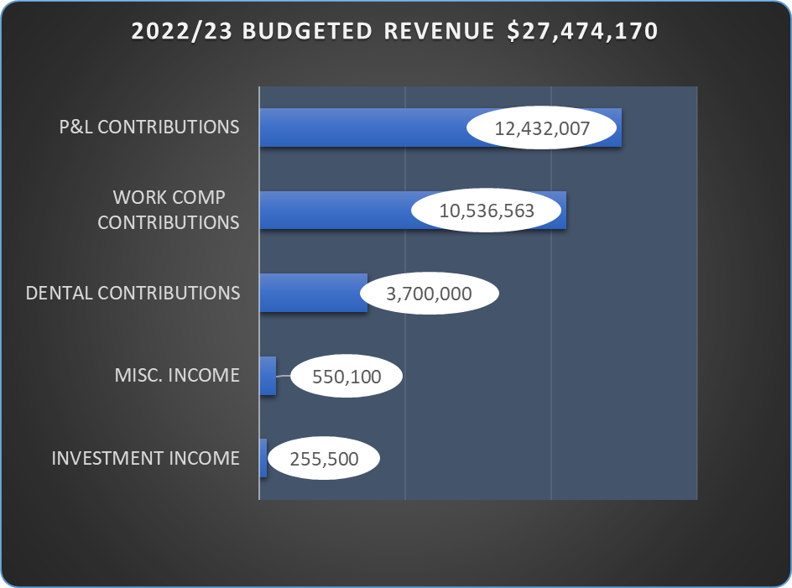

Slide 17
For every $1 of revenue to RESIG…..

Slide 18
RESIG 2022/23 BUDGETED REVENUE AND EXPENSES
This is a balanced budget, meaning that budgeted revenue exceeds expenditures and provides a budgeted increase to net position projected to be $566,000 total across all programs as of June 30, 2023.
Provision for claims include purchased insurance (Excess) and claims expense which is 75% of total expenses.
Operating expenses, salaries and benefits is 25% of total expenses.

Slide 19
How have changes in exposures for Cotati-Rohnert Park impacted Property/Liability costs through RESIG?

Slide 20
Cotati-Rohnert Park P/L cost trends
EXPOSURES | 2017/18 | 2018/19 | 2019/20 | 2020/21 | 2021/22 | 2022/23
Property values | 156,124,246 | 164,428,244 +5.3% | 172,009,782 +4.6% | 245,996,433 +43% | 243,348,080 -1% | 251,923,838 +3.5%
ADA (as of Sept 1, prior year lottery ADA) | 5804 | 5850 +1% | 5790 -1% | 5752 -1% | 5694 -1% | 6046 +6.1%
Experience Mod (adjusted) | 0.90 | 1.13 +.23 | 0.76 -.37 | 0.79 +.03 | 1.30 +.51 | 1.44 +.14
CONTRIBUTIONS
Self-Insured layer | $164,564 | $217,106 +31.9% | $156,734 -27.9% | $230,875 +47.3% | $406,993 +76.2% | $470,183 +15.5%
Excess Insurance layer | $213,755 | $215,948 +1% | $396,306 +83.5% | $600,754 +51.5% | $673,946 +12.1% | $821,952 +21.9%
Total contribution | $378,319 | $433,054 +14.4% | $553,040 +27.7% | $831,629 +50.37% | $1,080,939 +29.9% | $1,292,135 +19.5%

Slide 21
RESIG is asking questions and taking action
How can we reduce costs?
Have fewer claims. Engage with RESIG’s loss prevention resources through the EHS Department
Self-insure more? More risk may not translate to savings if catastrophic claims occur. RESIG looks at options every year
Can RESIG own our own insurance company (i.e. a captive insurer)? This is part of the strategic plan considerations
Approach other markets? This is an annual exercise and is underway currently
Organically reduce operational expenses? We are working on that now through departmental reorganizations
How can we bring in more revenue?
Conference room rental
Growth

